Slide 1
Hypothesis Testing with Python: Step by step hands-on tutorial with practical examples
https://towardsdatascience.com/hypothesis-testing-with-python-step-by-step-hands-on-tutorial-with-practical-examples-e805975ea96e

Slide 2
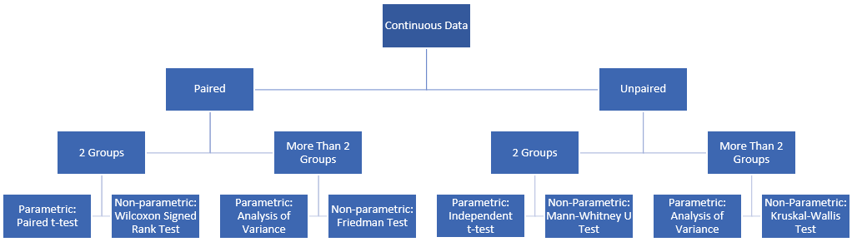

Slide 3
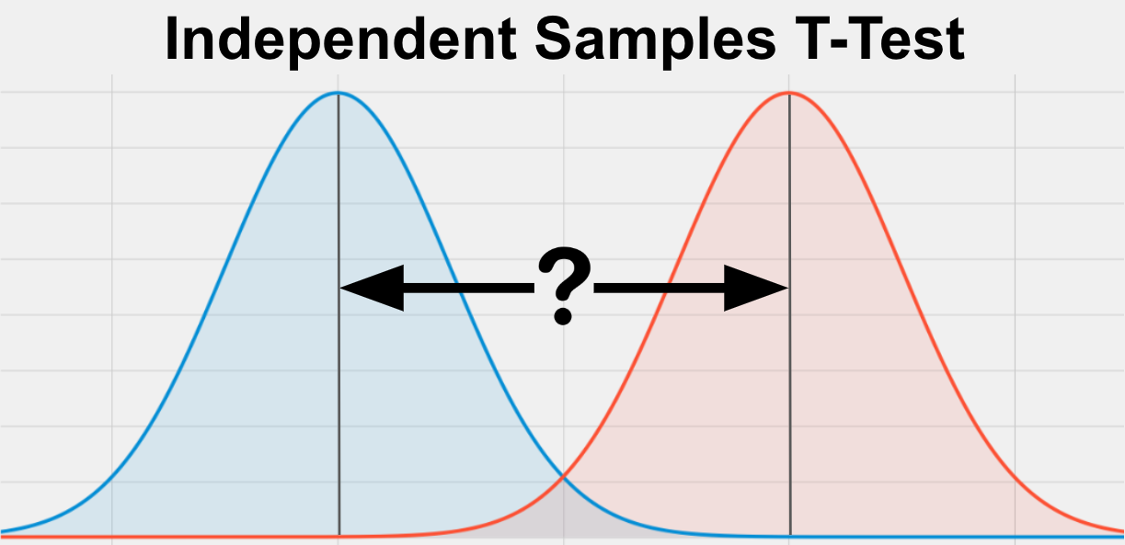
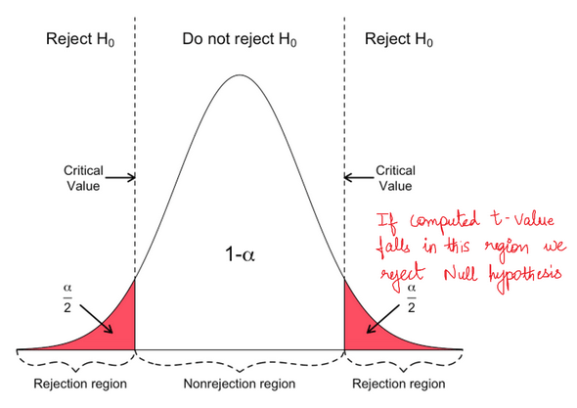
Q1. Independent Samples t Test
The Independent Samples t Test compares the means of two independent groups in order to determine whether there is statistical evidence that the associated population means are significantly different. The Independent Samples t Test is a parametric test.
This test is also known as:
Independent t Test, Independent Measures t Test, Independent Two-sample t Test, Student t Test, Two-Sample t Test, Uncorrelated Scores t Test, Unpaired t Test, Unrelated t Test
The variables used in this test are known as:
Dependent variable, or test variable; Independent variable, or grouping variable
https://libguides.library.kent.edu/spss/independentttest

Slide 4
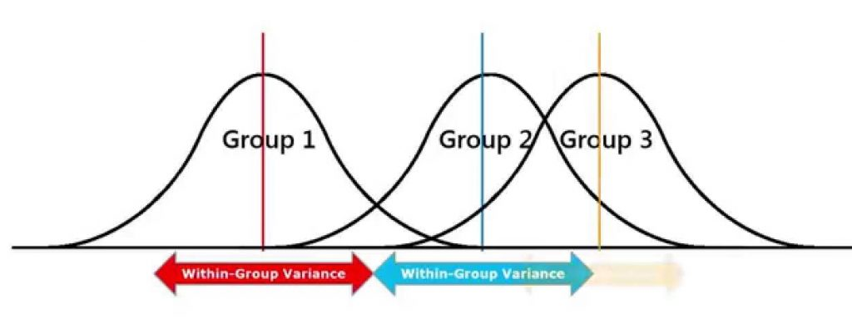
Q2. Anova
One-Way ANOVA ("analysis of variance") compares the means of two or more independent groups in order to determine whether there is statistical evidence that the associated population means are significantly different. One-Way ANOVA is a parametric test.
This test is also known as:
One-Factor ANOVA, One-Way Analysis of Variance, Between Subjects ANOVA
The variables used in this test are known as:
Dependent variable; Independent variable (also known as the grouping variable, or factor). This variable divides cases into two or more mutually exclusive levels, or groups
https://libguides.library.kent.edu/SPSS/OneWayANOVA

Slide 5
Q3. Mann Whitney U
When one or more of the assumptions for the Independent Samples t Test are not met, you may want to run the nonparametric Mann-Whitney U Test instead.
nonparametric
https://libguides.library.kent.edu/spss/independentttest

Slide 6
Q4. Kruskal-Wallis
When the normality, homogeneity of variances, or outliers assumptions for One-Way ANOVA are not met, you may want to run the nonparametric Kruskal-Wallis test instead.
nonparametric
https://libguides.library.kent.edu/SPSS/OneWayANOVA

Slide 7
Data, please welcome!
https://archive.ics.uci.edu/ml/index.php

